Slide 1




REL301M CAPSTONE PROJECT
Presented by: NguyenNHSE185109

Slide 2



GROUP MEMBER
Donna Stroupe
Estelle Darcy
Hannah Morales

Slide 3

PROJECT BACKGROUND
Reliable medical information is hard to access in many areas, and online self-diagnosis can cause misinformation.
Standard LLMs lack structured reasoning and may give unsafe advice, so improved AI assistants are needed for safe, relevant guidance.

Slide 4

PROJECT GOALS
Fine-tune the model with Direct Preference Optimization (DPO) to align with ReAct and improve reasoning quality for vietnamese users.
Build a Vietnamese medical agent using ReAct and MedGemma 4B, leveraging retrieval tools.

Slide 5

TIMELINE
Week 1
Study the ReAct architecture and main components
Learn to integrate external APIs
Week 2
Select an environment or simple tasks
Build a basic ReAct agent to reason and take action
Week 3
RL post-prompt training to boost performance
Evaluate planning and act abilities, write report

Slide 6
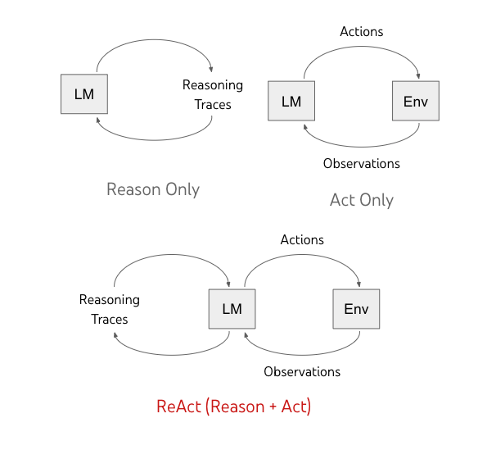
METHODOLOGY
The ReAct architecture (Reason + Act) interleaves 3 key steps to synergizes reasoning and acting:
Thought: The agent thinks and plans its next move
Action: It carries out an action, like searching or asking a question
Observation: It reviews the result, updating its understanding before starting the cycle again

Slide 7
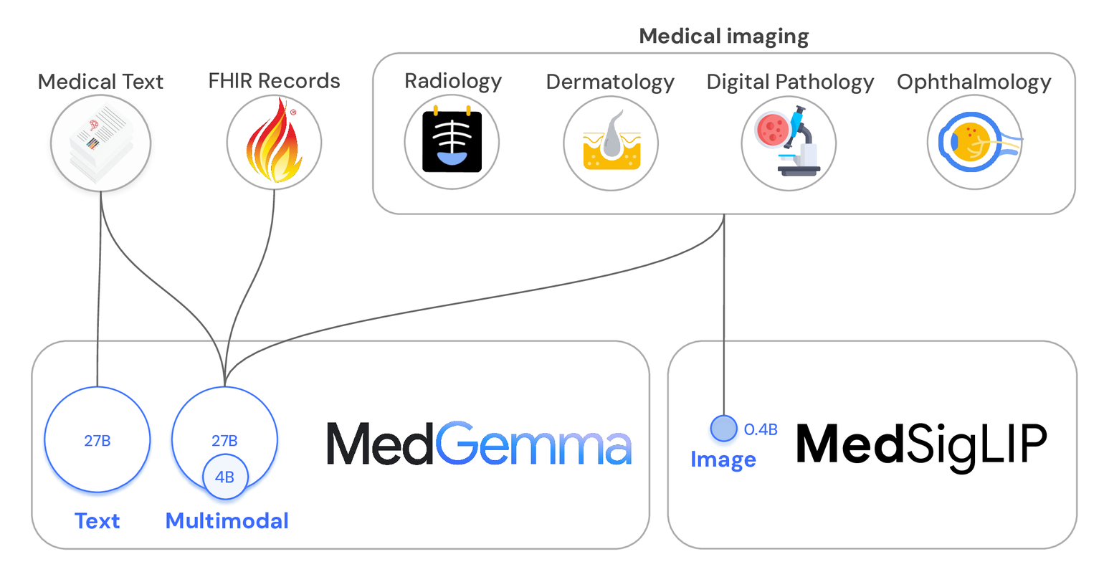
MODEL - MEDGEMMA 4B

Slide 8
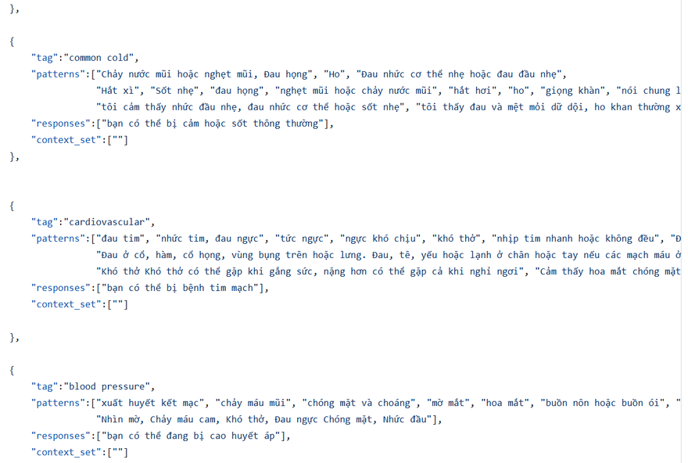
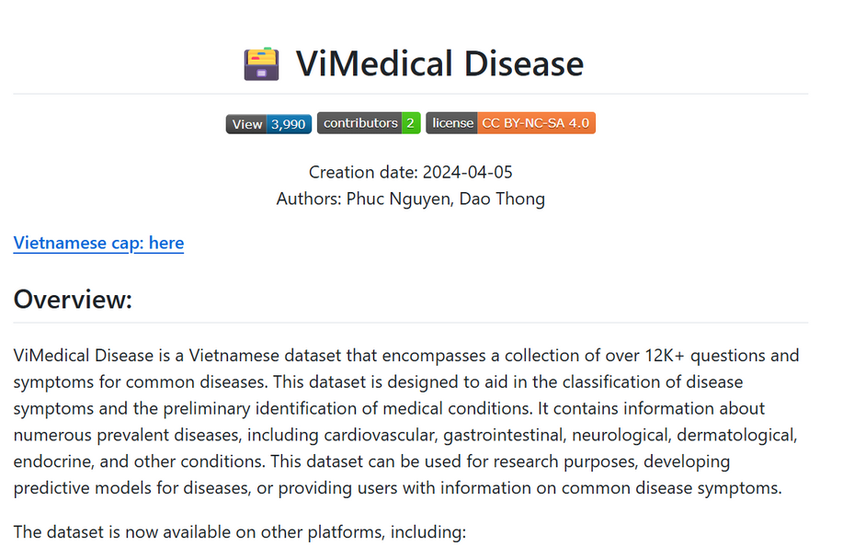
DATA - KNOWLEDGE BASE
XuanHien304/Vietnamese-medical-chatbot-based/data/intent_train.json
PB3002/ViMedical_Disease

Slide 9
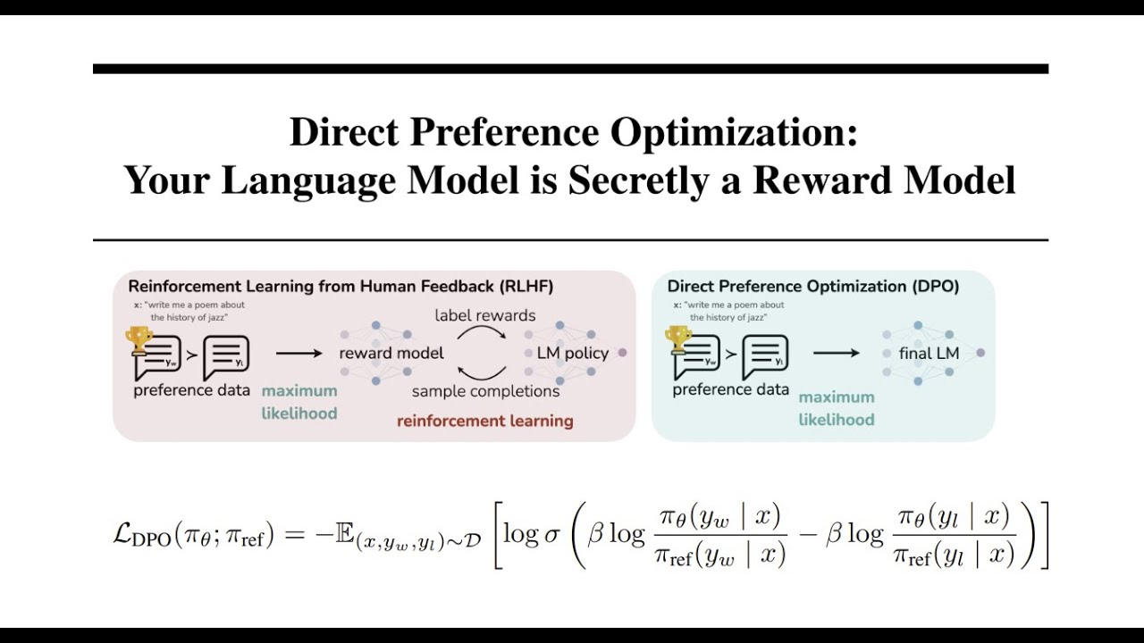
DIRECT PREFERENCE OPTIMIZATION (DPO)

Slide 10
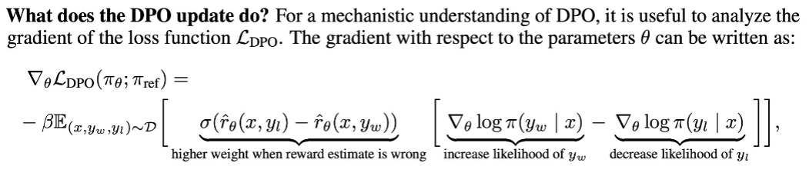
DIRECT PREFERENCE OPTIMIZATION (DPO)

Slide 11
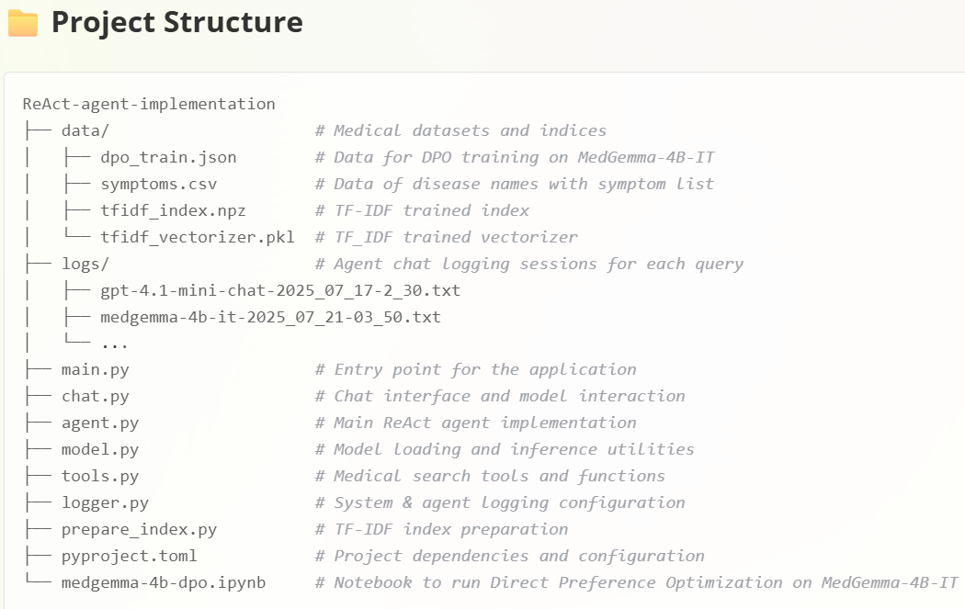
IMPLEMENTATION - PROJECT STUCTURE

Slide 12
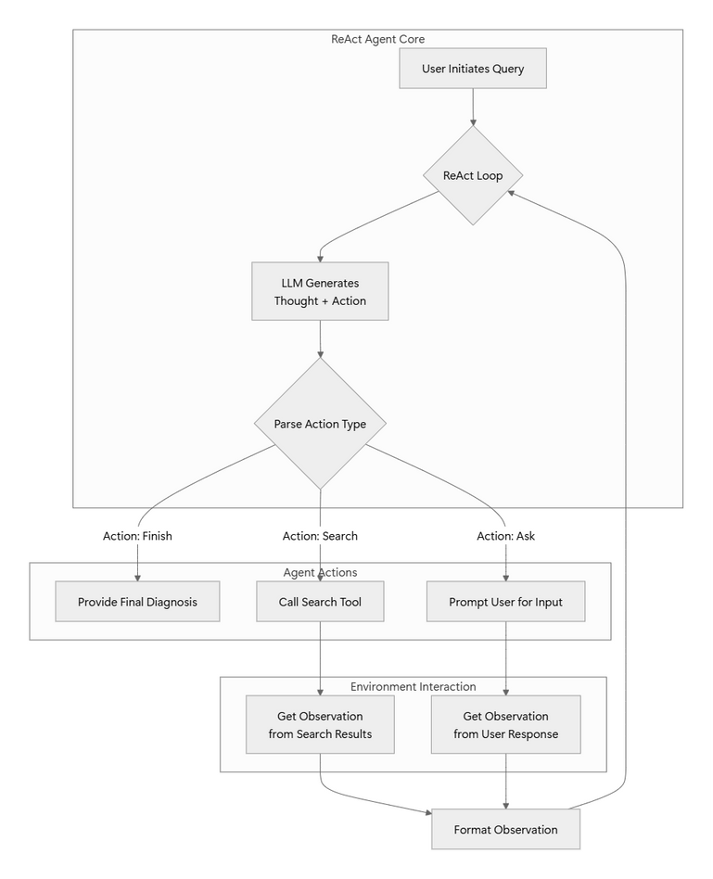
IMPLEMENTATION - SYSTEM ARCHITECTURE

Slide 13
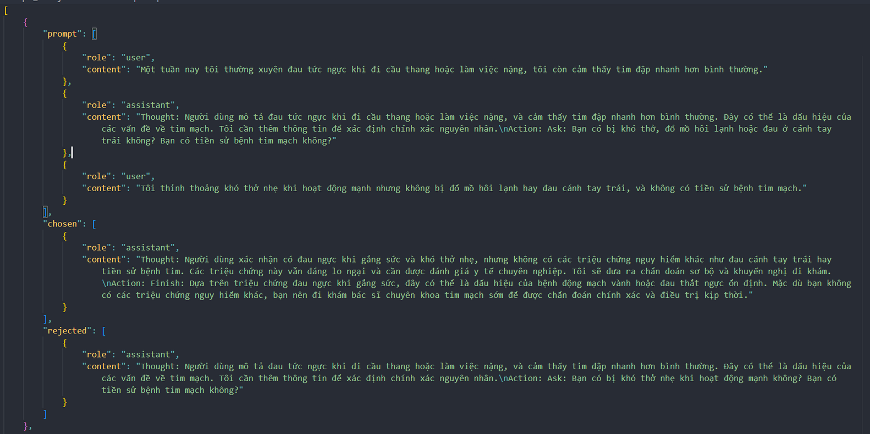
IMPLEMENTATION - DPO DATASET
Generated 10 samples of prompt messages, chosen output and rejected output using LLM from agent chat logs

Slide 14
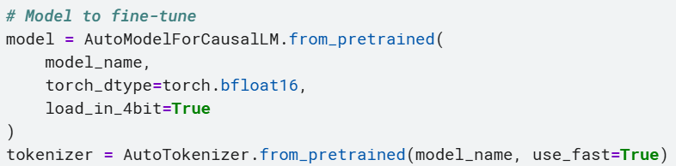
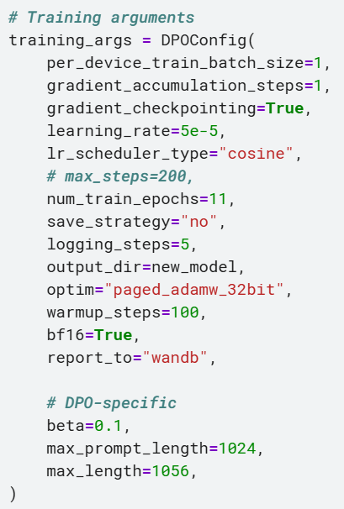
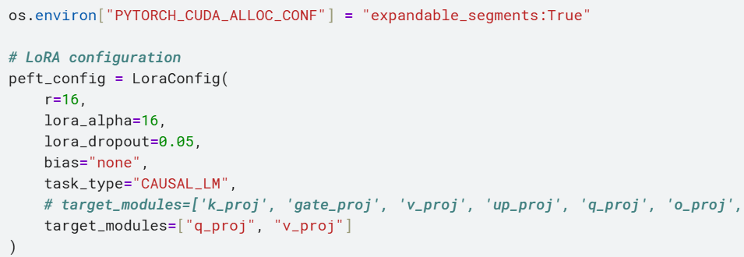
IMPLEMENTATION - DPO TRAINING
Since resources are scarce, apply QLoRA before preference tuning the model.

Slide 15
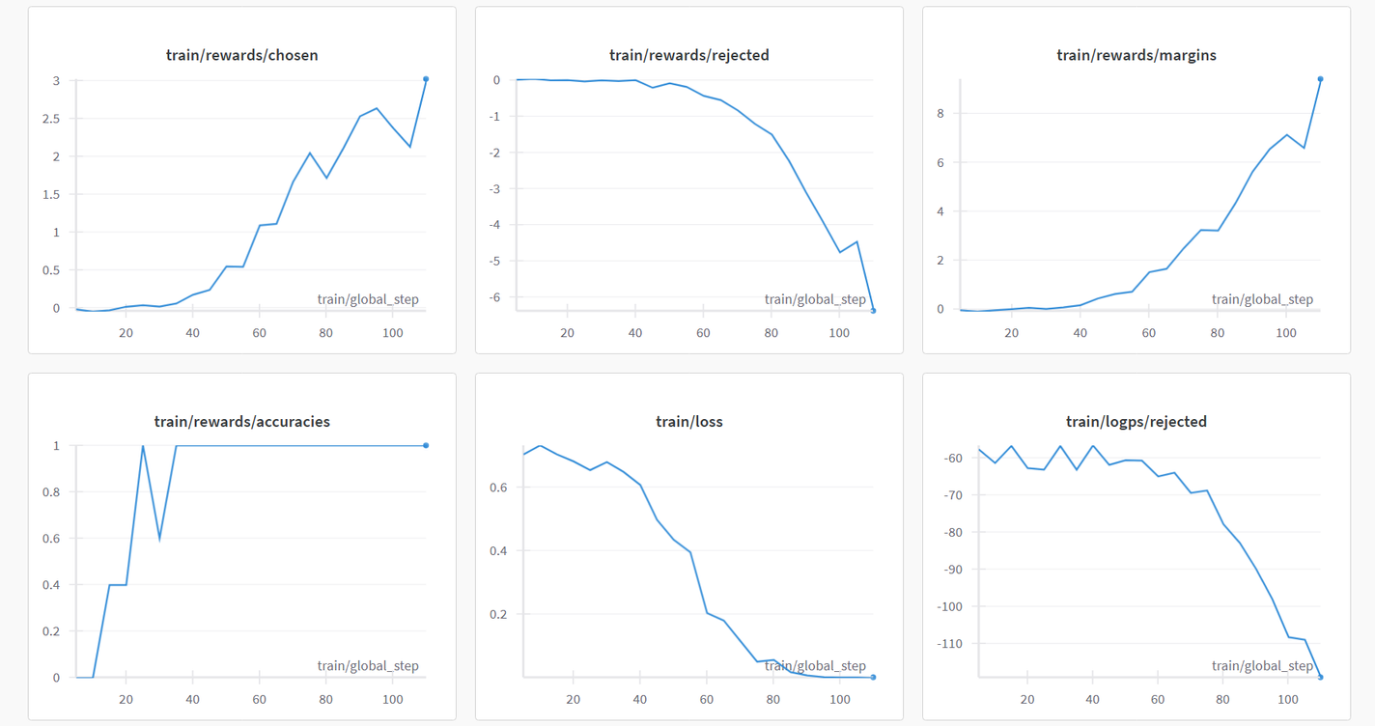
RESULT - DPO TRAINING
The reward for chosen responses increases as the reward for rejected responses declines, as expected. Reward accuracy remains at 1 after a certain point.

Slide 16
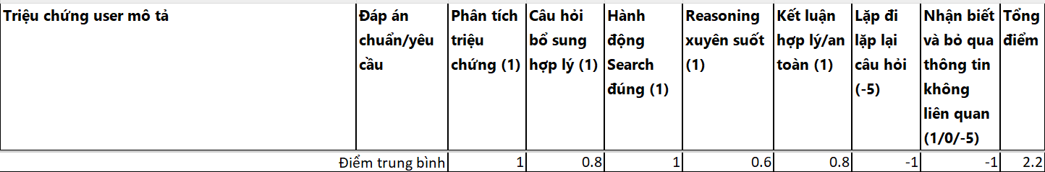
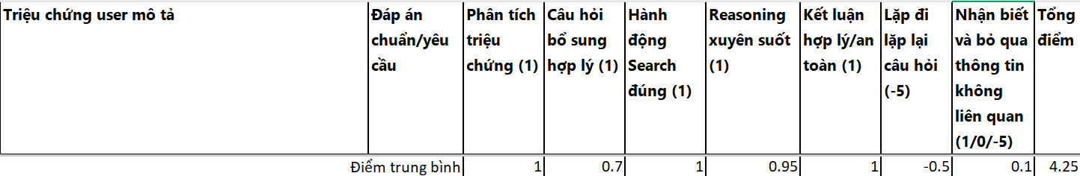
RESULT - TEST MODELS
Original model
Model after DPO

Slide 17
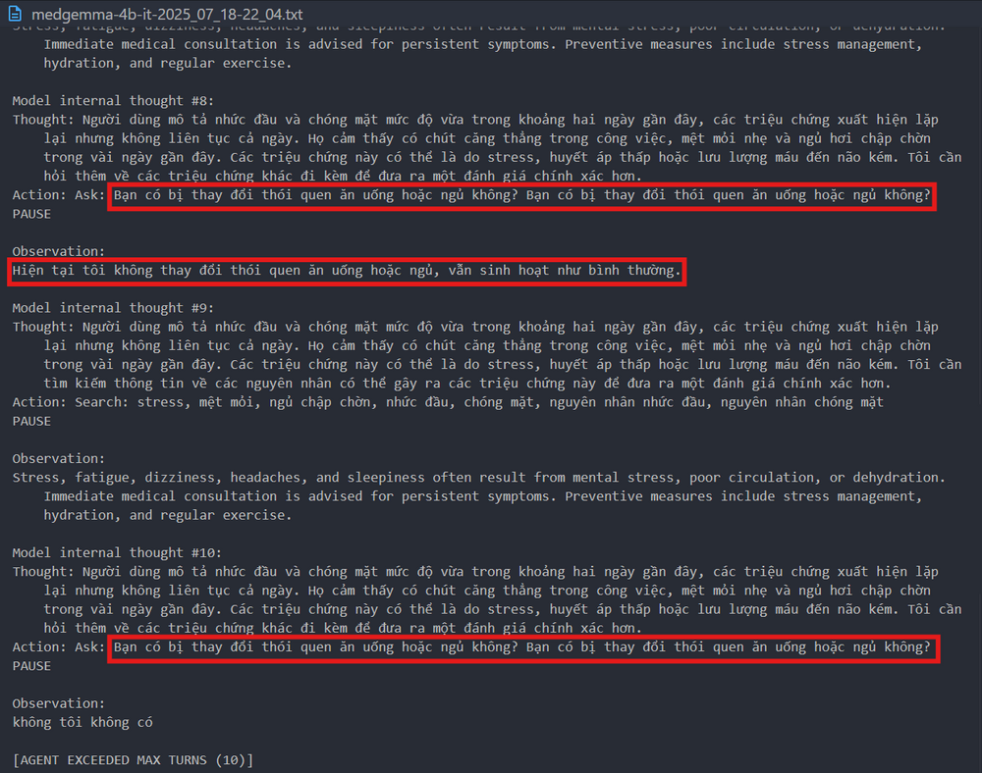
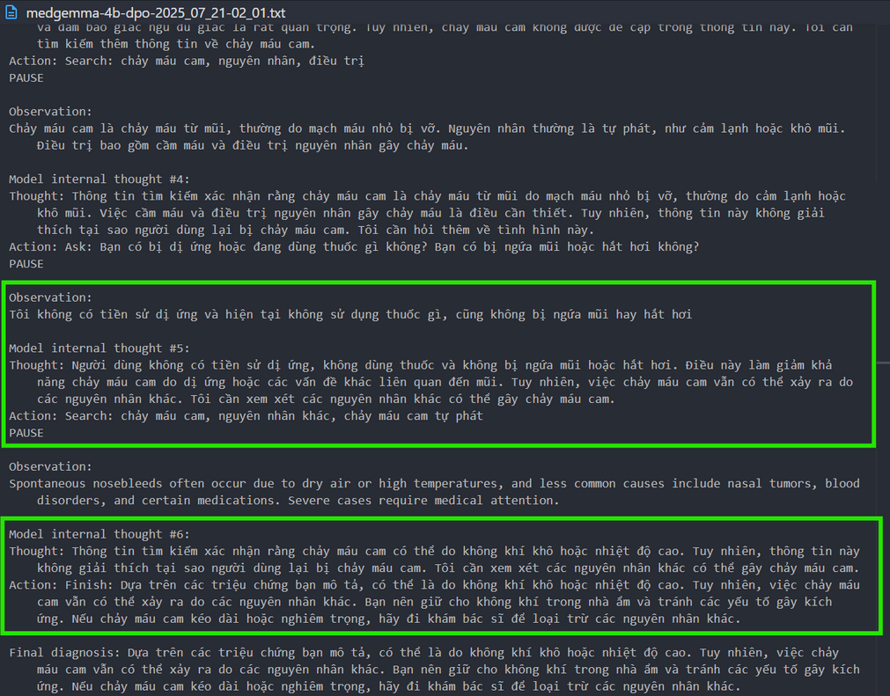
RESULT - TEST MODELS
Original model
Model after DPO

Slide 18
CONCLUSION
DPO showed significant improvement even with just 10 samples, raising the total average score from 2.2 to 4.25
The greatest improvement is in recognizing and disregarding irrelevant information.
However, it still occasionally forgets user-provided symptoms across turns, resulting in repeated questions.
All other evaluation criteria also improved notably after applying DPO, with individual max score went up to 6.

Slide 19
IMPROVEMENT SUGGESTION
Update the system prompt to maintain context across chats and prevent repeating or forgetting information.
Add a tool to log symptoms into a persistent memory record.
Enhance the search tool to handle multiple queries or synthesize data from various sources.

Slide 20
THANK YOU

